Slide 1
Welcome

Slide 2
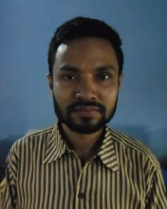
Introduction
MD. SHIBLY NOMANY
ASST. TEACHER (COMPUTER)
K.B.SCHOOL AND COLLEGE

Slide 3
INTRODUCTION OF LESSON
CLASS: VIII
SUBJECT: ENGLISH 1ST PAPER
TOPIC: RIVER GYPSIES IN BANGLADESH
TIME: 50 MINUTES
DATE: 04-08-2013

Slide 4
LEARNING OUTCOMES
After we have studied this unite, we will be able to--------
Know about the RIVER GYPSIES IN Bangladesh
Ask and answer question.
Read and understand texts.
Make a dialogue between two friends about the river gypsies in Bangladesh
Write answers to questions.
Write a short paragraph.

Slide 5
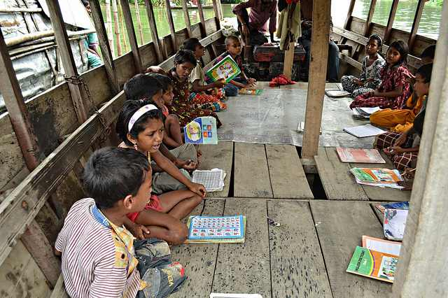
Look at the picture
They are reading

Slide 6
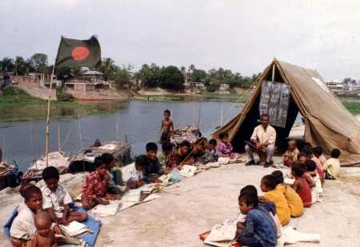
Look at the picture
A teacher is teaching
Notes:
A teacher is teaching

Slide 7
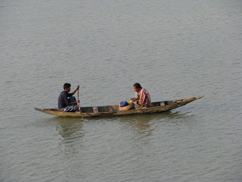
Look at the picture
They are catching fish

Slide 8
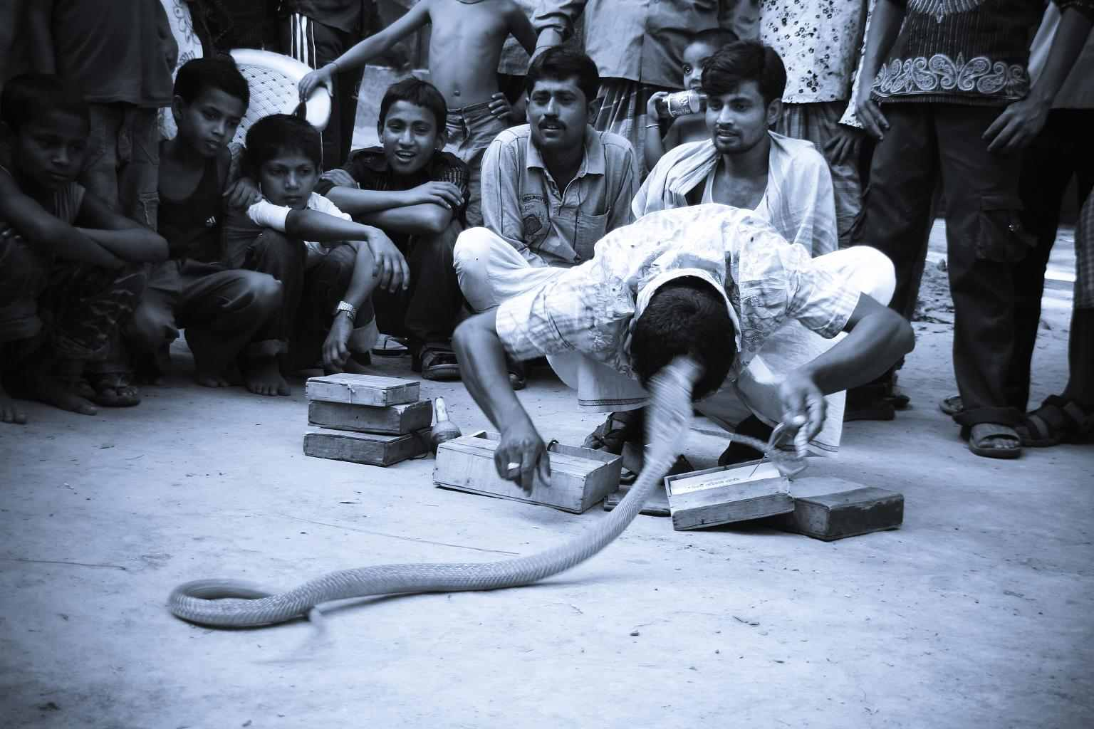
A gypsy is showing play

Slide 9
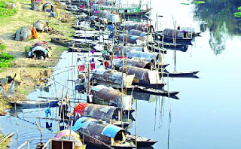
It is their life style

Slide 10
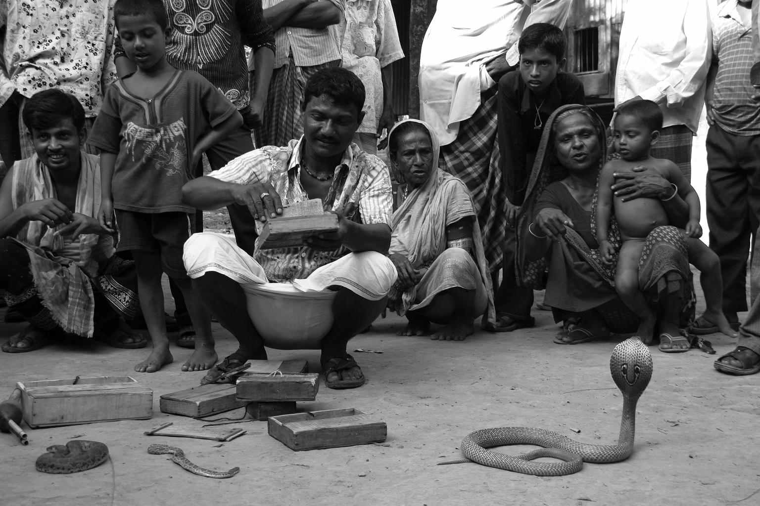
A gypsy is sowing play

Slide 11
Read the text about the river gypsies in Bangladesh

Slide 12
NEW WORDS
Gypsy বেদে,যা্যাবর
Ethynic নৃতাত্ত্বিক
Harbal ভেষজ
Nomadic যাযাবর
Tent তাবু
Bangle বালা,চুড়ি
Tarpaulin ত্রিপল
Remedy প্রতিষেধক
Vend বিক্রয় করা
Talisman তাবিজ

Slide 13
True/False
The local people call the gypsie baday.
River gypsies are religious group in Bangladesh.
. The gypsies follow our lifestyle
They live seperatery.
They have their own land.

Slide 14
ANSWER
Correct information: True
False.Corr.Inf: River gypsies are ethnic group in Bangladesh.
False.Corr.Inf: The gypsies follow their lifestyle.
False.Corr.Inf:They live group.
False.Corr.Inf:They have no land.

Slide 15
Fill in the blanks with suitable words
The river gypsies are among the Nation’s -------groups
A 2oo7 report said -------percent live below the poverty line.
Only 2 percent of gypsy children are given primary -------
Most gypsy children travel with their parents for an -------------- 8 months of the year
So they end up in a cycle of --------
Ans : (1 ) ethnic (2) 54 (3) school education (4) about (5) waters

Slide 16
Group Work
Write five sentences about river gypsies in Bangladesh.

Slide 17
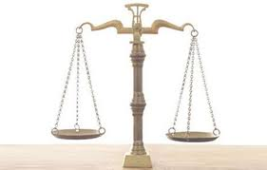
Evaluation
Who are river gypsies ?
How do they live ?
What do river gypsies do in winter?
What do river gypsy men do for a living?
What do river gypsy women do for a living?

Slide 18
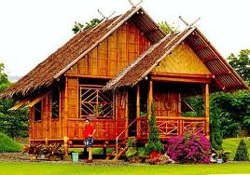
Home Work
Write a dialogue between two friends about the river gypsies in Bangladesh.

Slide 19
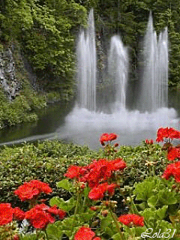
THANKYOU

